Slide 1
Development of an ELT Tool for Data Analysis of Kaggle Data
Using Python, PostgreSQL, Docker, Docker Compose, Airflow, DBT and BigQuery to Analyze Brazilian E-Commerce Data
August, 2024
Ifeanyi Franklin Ike

Slide 2

Project Overview
Brazilian E-Commerce dataset is a public dataset of orders from Olist Store at multiple marketplaces in Brazil.
With 100,000 orders
From 2016 – 2018
It contains the following datasets (csv) used in this project:
Orders, Customers, Sellers, Products, Geolocation, Order payments, Order reviews and Order items
This project is therefore set up to:
Develop an ELT tool for handling the csv data from Kaggle
Extract insights and answer key business questions regarding the Brazilian c-commerce data.

Slide 3
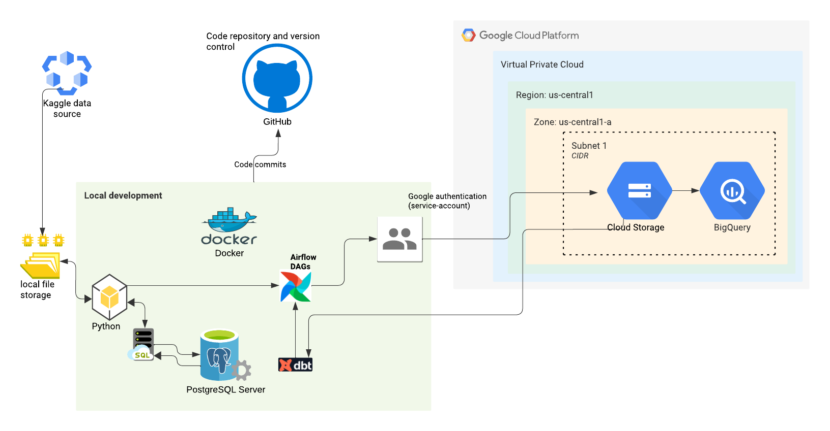
System Architecture & Tool Stack
Python
DBT
Docker & Docker-compose
Apache-Airflow
GCS
PostgreSQL
Google BigQuery

Slide 4
Research Questions
Which product categories have the highest sales?
What is the average delivery time for orders?
Which states have the highest number of orders?

Slide 5
Methodology
Approach:
Local file
PostgreSQL
GCS
BigQuery
DBT
Data Pipeline:
Ingestion: Raw data ingested into PostgreSQL using SQLAlchemy
Loading/storage to cloud: Data loaded to GCS and BigQuery from PostgreSQL.
Transformation: Data modeled using DBT in BigQuery.
Analysis: Queries run and saved on the transformed data in BigQuery.

Slide 6
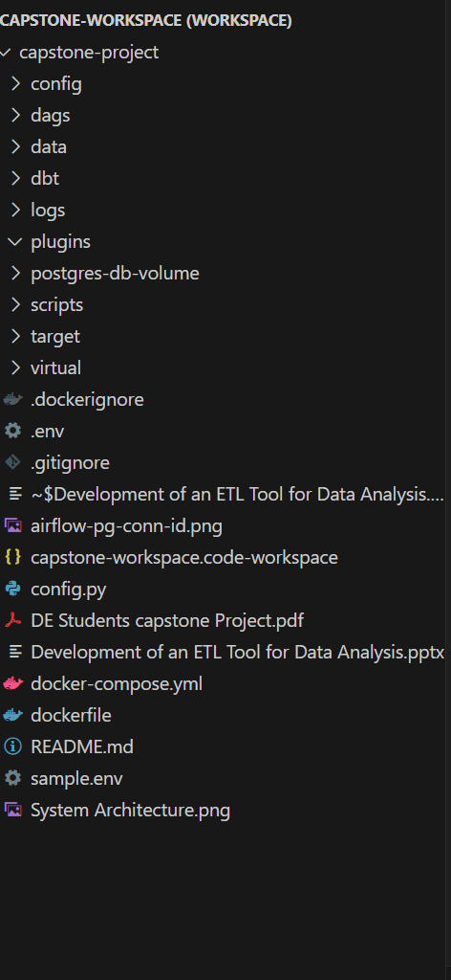
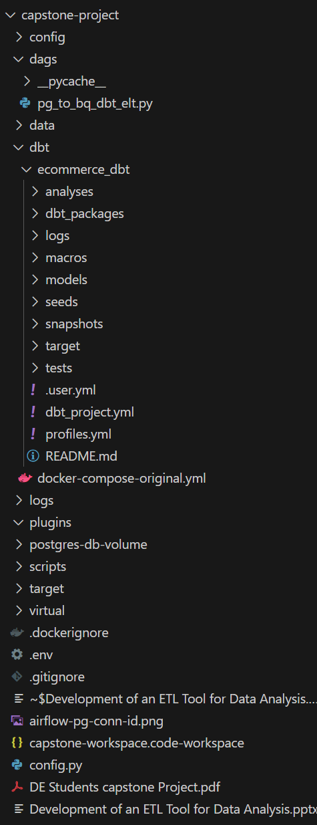
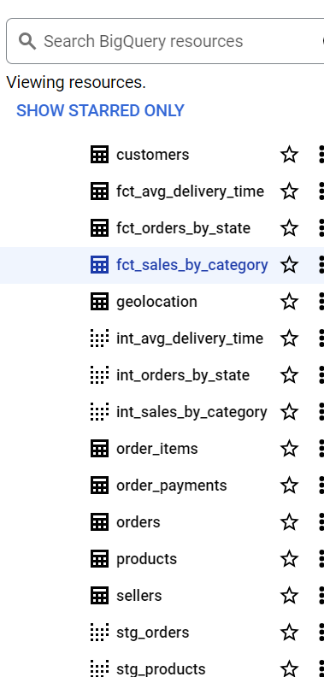
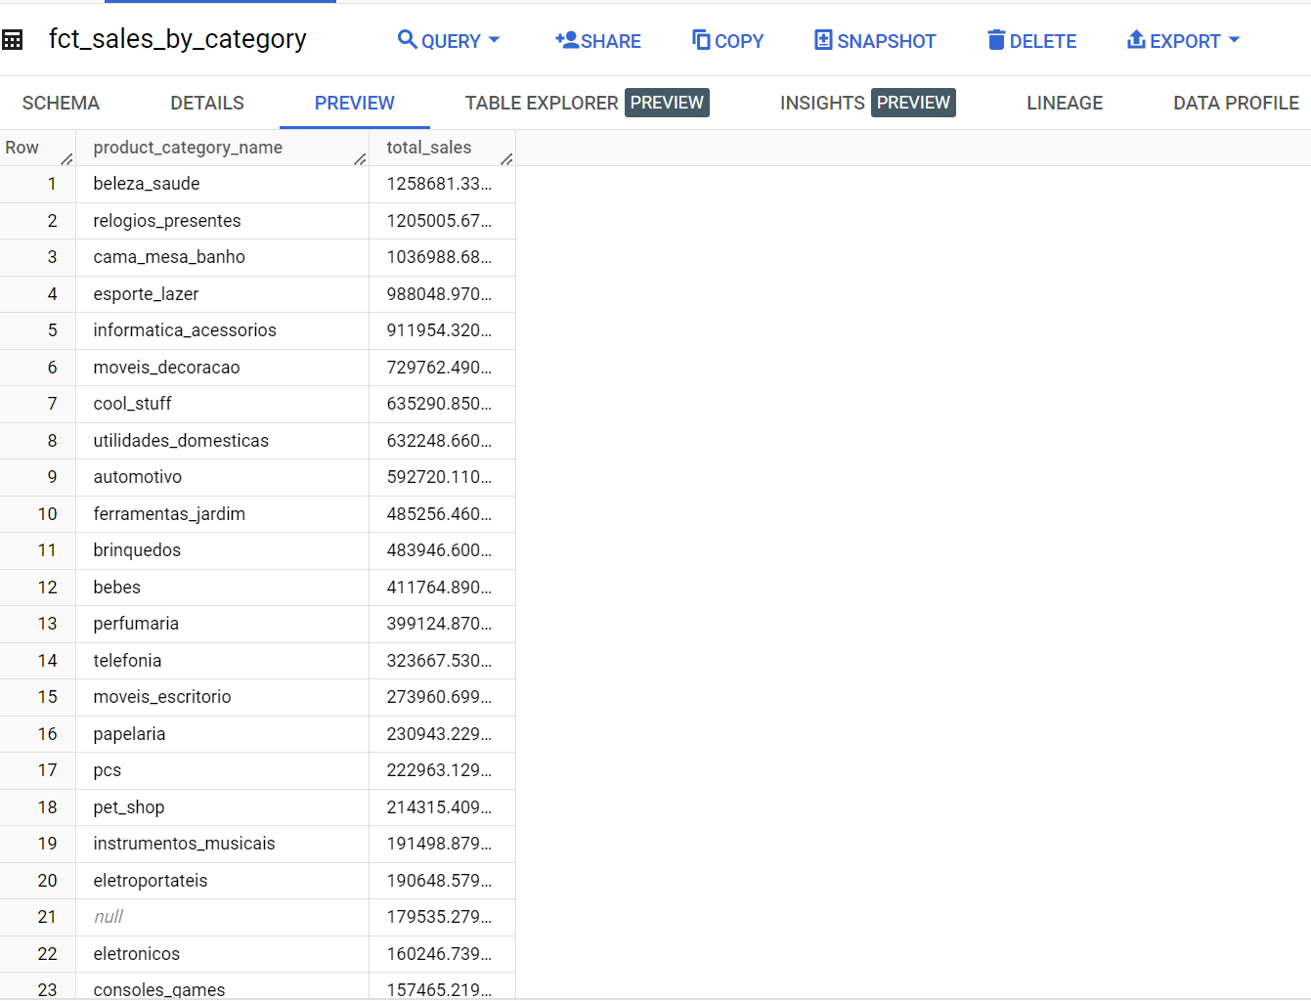
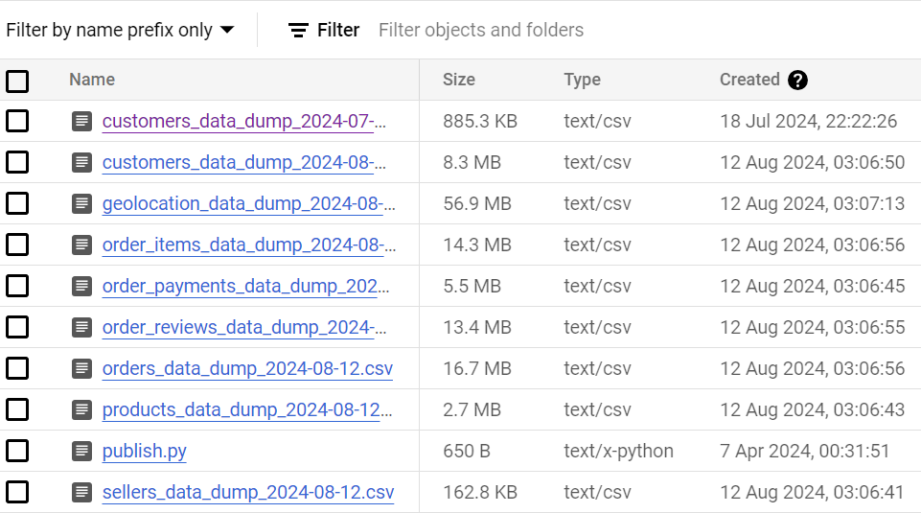
Snapshots of Code and Results
Directory management for the project
Data stored in BigQuery
Data stored in GC Bucket

Slide 7
Answer to Question 1 - Highest Sales by Product Category
Key Insight:
Product category with highest sales was Beleza Saude with 1258681.34 sales
Other 3 categories with very high sales :
Relogios Presentes (1205005.68 sales)
Cama Mesa Banho (1036988.68 sales) and
Esporte Lazer (988048.97 sales)

Slide 8
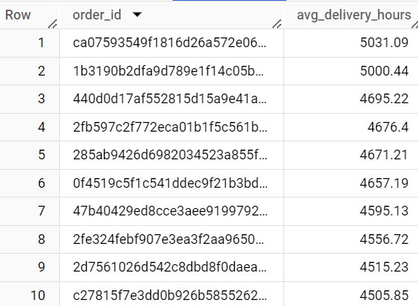
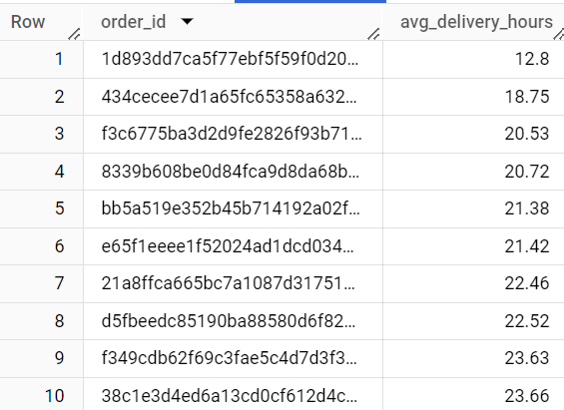
Answer to Question 2 - Average Delivery Time
Top 10 orders with highest delivery time (hours)
Key Insight:
Average delivery time: 301.4 hours
Top 10 orders with lowest delivery time (hours)

Slide 9
Answer to Question 3 - Orders by State
Key Insight:
The State with the highest order: SP with 41,746 orders
Top 3 States with the highest orders:
SP 41,746
RJ 12,852
MG 11,635

Slide 10
Conclusion
This project has developed an end-to-end ELT tool using a combination of Docker, PostgreSQL, Airflow, DBT and GCP.
The project also simplifies data modelling and querying to answer business intelligence questions.
The project can therefore be adopted in order datasets by changing the configurations.

Slide 11
Thank you

Slide 12
Additional Resources
Project repository:
https://github.com/ififrank2013/ELT-Tool-for-Data-Analysis-Capstone-Project
Learn more about dbt
https://docs.getdbt.com/docs/introduction
Check out [Discourse]
https://discourse.getdbt.com/
for commonly asked questions and answers

